Slide 1
개발 방법론 비교 이해
Bok, Jong Soon
javaexpert@nate.com

Slide 2
Now is

Slide 3
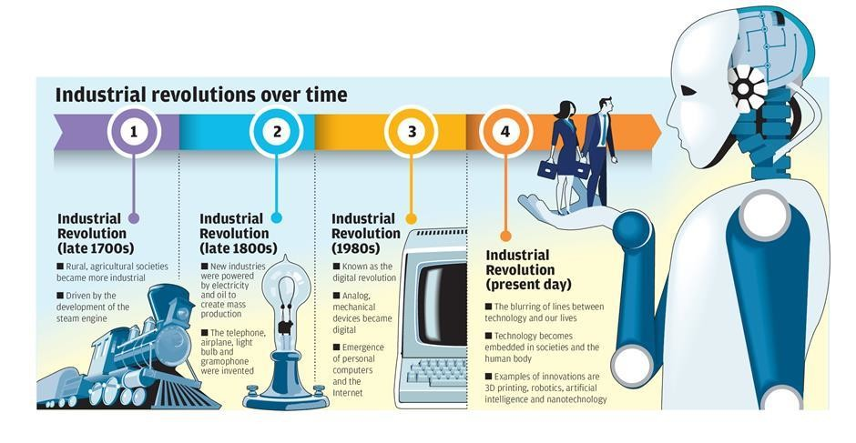
4th Industrial Revolution
https://www.linkedin.com/pulse/crm-fourth-industrial-revolution-clint-oram

Slide 4
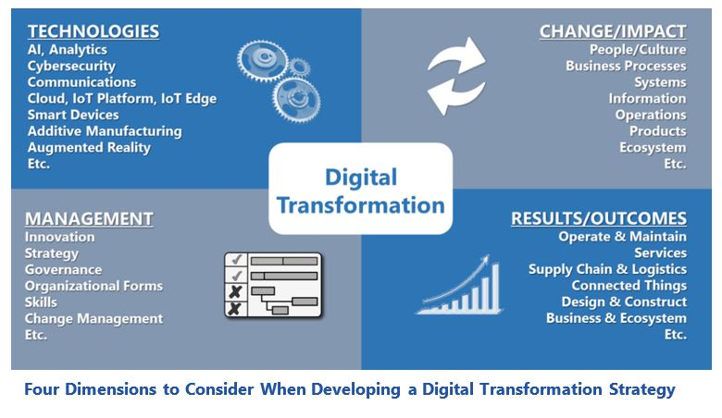
Digital Transformation
https://www.arcweb.com/blog/industrial-digital-transformation-snapshot-strategies-success

Slide 5
Digital Transformation
IoT
Cloud
Big Data
AI

Slide 6
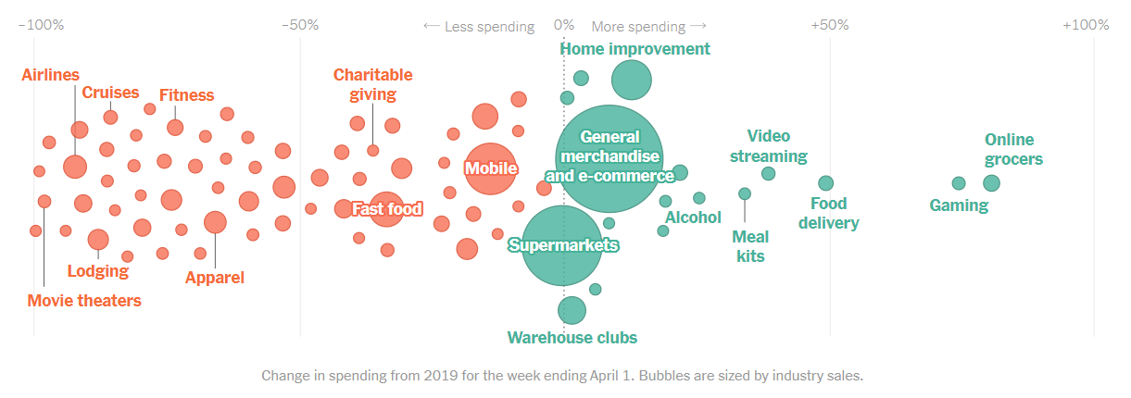
Post Pandemic(COVID-19) and Business Trend
https://www.nytimes.com/interactive/2020/04/11/business/economy/coronavirus-us-economy-spending.html

Slide 7
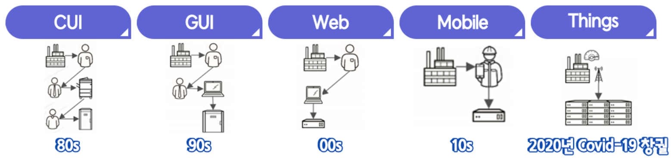
Post Pandemic(COVID-19) and Business Trend
e-koreatech, “CI/CD를 통한 DevOps 엔지니어링 이해“, 2회차

Slide 8
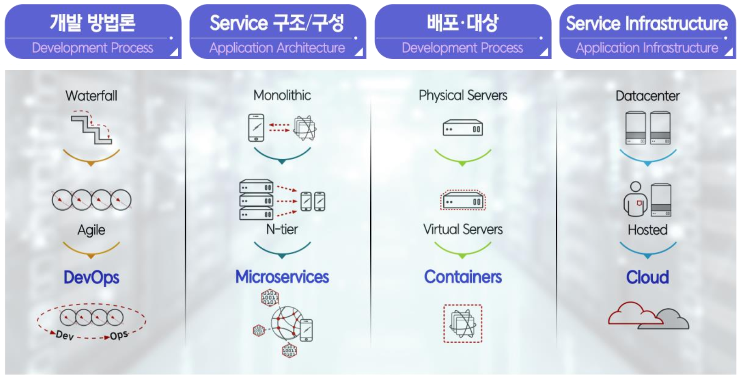
Legacy Enterprise IT Architecture
e-koreatech, “CI/CD를 통한 DevOps 엔지니어링 이해“, 2회차

Slide 9
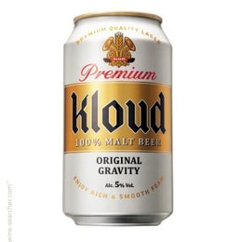

Cloud Computing
Service on Demand, Pay-as-you-go
Origin : More and more, companies will fulfill their IT requirements simply by purchasing fee-based Web services from third parties – similar to the way they currently buy electric power or telecommunications services.
- 『IT Doesn’t Matter』, Nicholas Carr, 2003
Proposal : in 2006, Google CEO Eric Schmidt proposed the concept of cloud computing. AWS was founded in 2006, marking the birth of cloud computing.

Slide 10

Cloud Computing
Service on Demand, Pay-as-you-go
Origin : More and more, companies will fulfill their IT requirements simply by purchasing fee-based Web services from third parties – similar to the way they currently buy electric power or telecommunications services.
- 『IT Doesn’t Matter』, Nicholas Carr, 2003
Proposal : in 2006, Google CEO Eric Schmidt proposed the concept of cloud computing. AWS was founded in 2006, marking the birth of cloud computing.

Slide 11
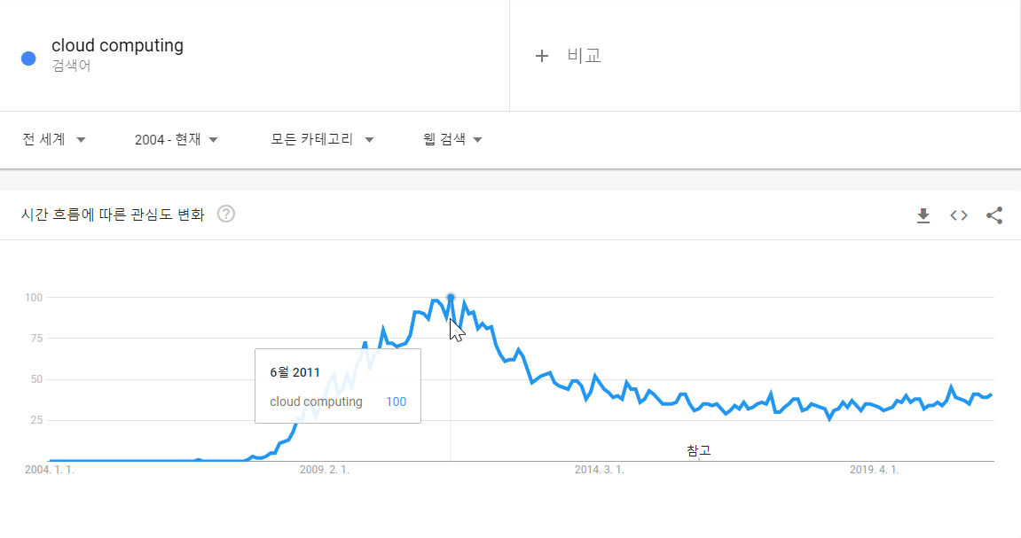
Cloud Computing (Cont.)
https://trends.google.com/trends/explore?date=all&q=cloud%20computing

Slide 12
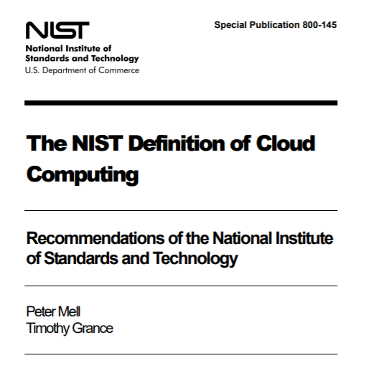
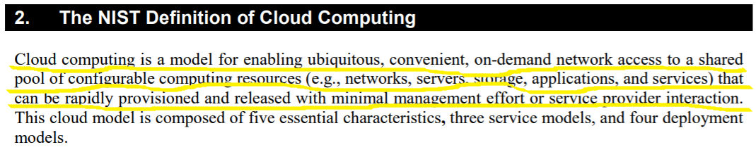
Cloud Computing (Cont.)

Slide 13
Cloud Computing (Cont.)
Features | Description
Massive scale | A public cloud often has hundreds of thousands or even millions of servers; a private cloud can have hundreds to thousands of servers.
High reliability | Multi-replica fault tolerance provides high reliability.
Isolation of tenants | Multiple tenants share the underlying hardware resources, but are logically isolated at the upper layers.
Elastic scaling | Dynamic scaling helps clients cope with the growth of their applications and their user base.
Service on demand | Cloud provides a large pool of resources that clients can purchase on demand.
Monitorable and measurable resources | Cloud platforms provide features for monitoring and measuring resources.
Low costs | Users only pay only for the resources they use, not the entire infrastructure.

Slide 14
Cloud Computing (Cont.)
Cloud computing is the on-demand delivery of IT resources over the Internet with pay-as-you-go pricing. Instead of buying, owning, and maintaining physical data centers and servers, you can access technology services, such as computing power, storage, and databases, on an as-needed basis from a cloud provider like Amazon Web Services (AWS).
클라우드 컴퓨팅이란 인터넷에서 종량 요금제 방식으로 클라우드 서비스 플랫폼을 통해 컴퓨팅 파워, 데이터베이스, 스토리지, 애플리케이션, 기타 IT 리소스를 온디맨드로 제공하는 서비스를 말합니다.
-Amazon Web Services 개요

Slide 15
Cloud Computing (Cont.)
Item | EDCs | Traditional IDCs | Cloud Computing
Rental Scope | None | L0, L1, and part of L2 | L0 – L4
Overall Costs | High | Moderate | Low
Launch Cycle | Long | Moderate | Very short
Ops Management | Complicated | Moderate | Simple
Scalability | Difficult | Moderate | Elastic scaling
Independence and Controllability | High | Moderate | Public cloud / private cloud

Slide 16
Cloud Computing
비대면 / Online
Mobile / Web
Credit Card
IT 공급 / 주문 Service
CRM / AI-based Service
장바구니 System
신속 배송 System

Slide 17
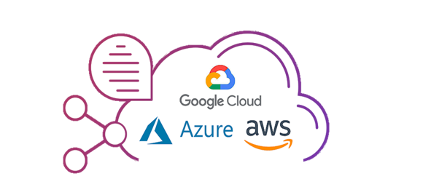
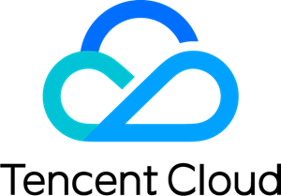
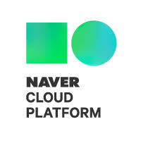

Cloud Computing
빌려줘!!
그래!!
(대신 쓴 만큼 돈은 내야해)

Slide 18
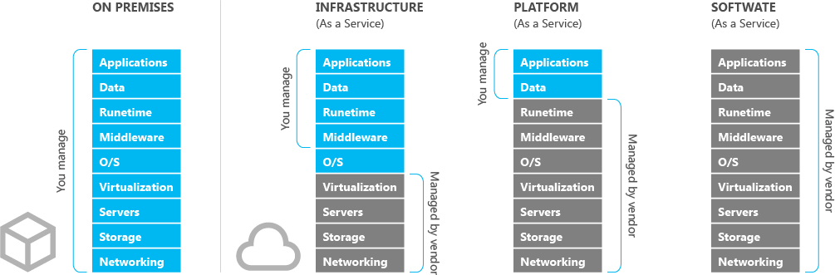
Cloud Computing – Reference Model
https://velog.io/@aonee/%ED%81%B4%EB%9D%BC%EC%9A%B0%EB%93%9C%EB%9E%80-nzrij240

Slide 19
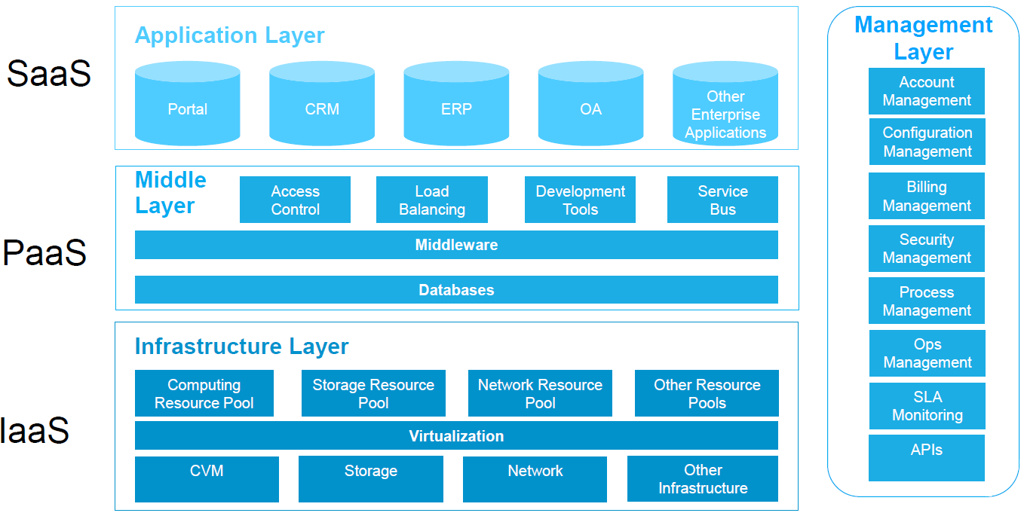
Cloud Computing – Reference Model (Cont.)

Slide 20

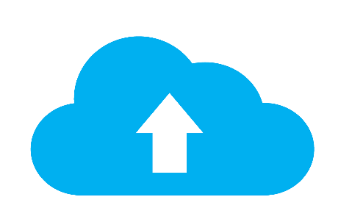

Cloud Computing – Reference Model (Cont.)
Deployment Models
Service Models
IaaS
Private Cloud
Community Cloud
PaaS
Public Cloud
SaaS
Hybrid Cloud

Slide 21
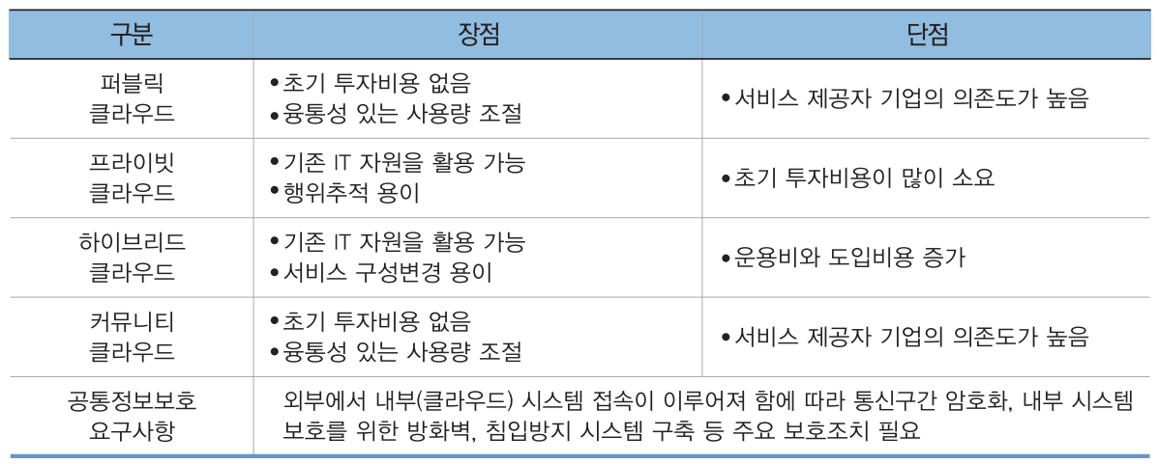
Cloud Computing – Reference Model (Cont.)

Slide 22
Legacy Enterprise IT Architecture
e-koreatech, “CI/CD를 통한 DevOps 엔지니어링 이해“, 2회차

Slide 23
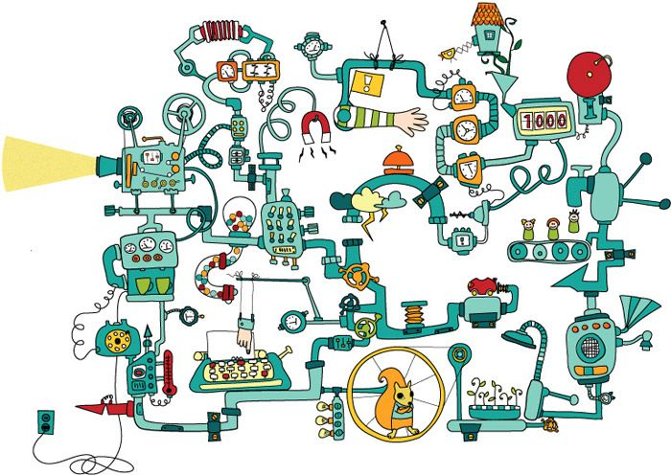
서버를 관리한다는 것은…
https://subicura.com/2017/01/19/docker-guide-for-beginners-1.html

Slide 24
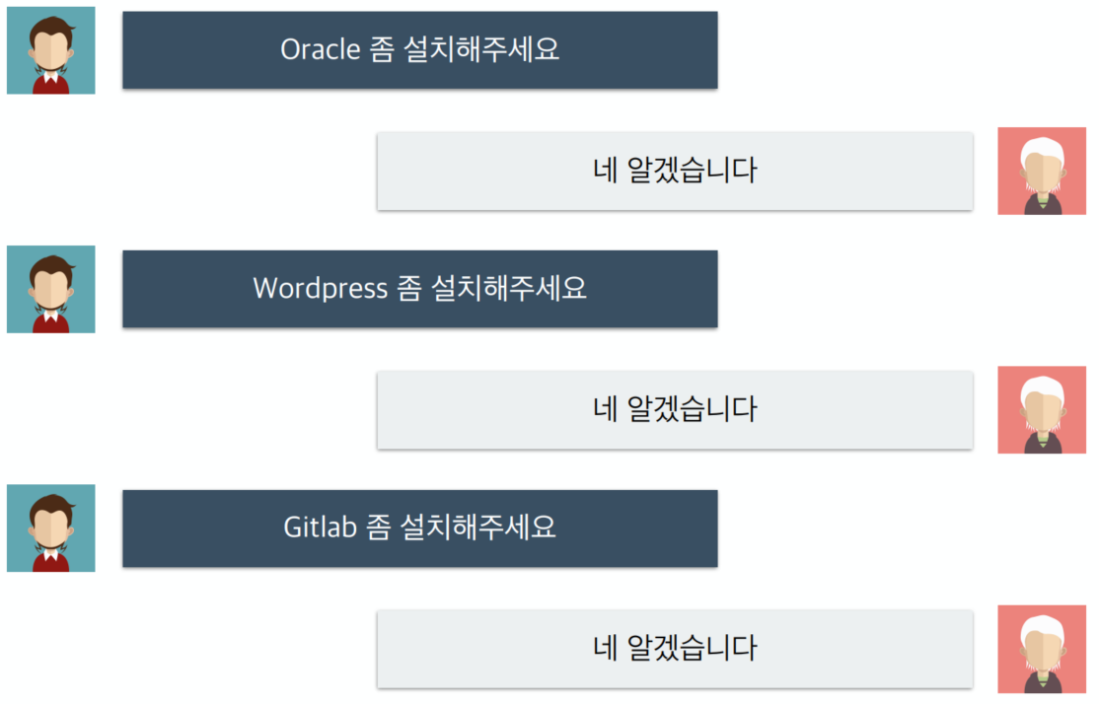
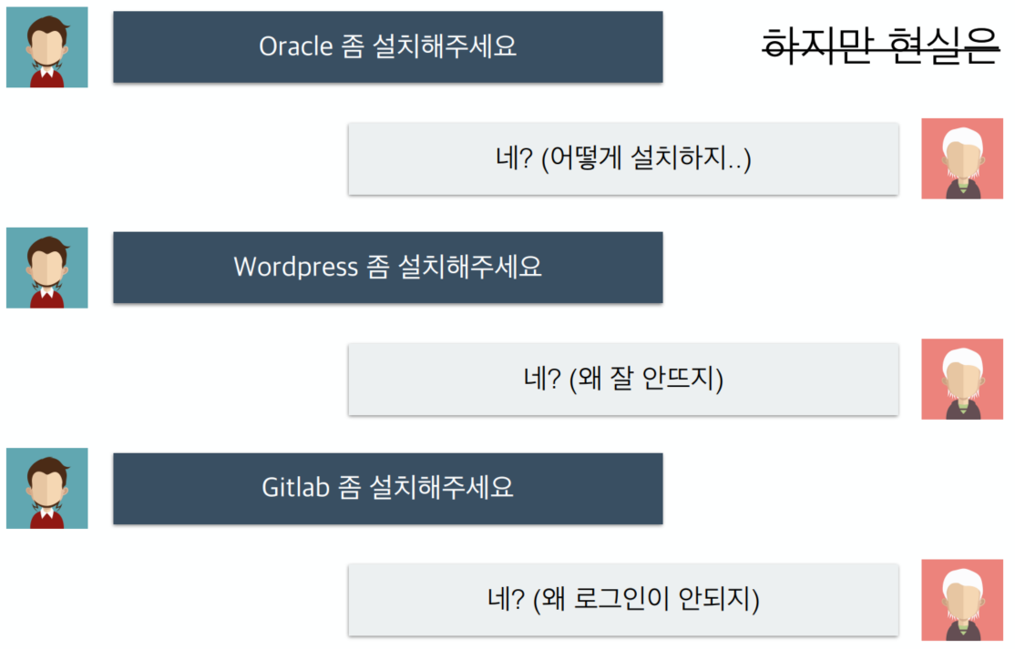
서버를 관리한다는 것은…
“도커란 무엇인가“, https://www.inflearn.com/course/도커-입문/

Slide 25
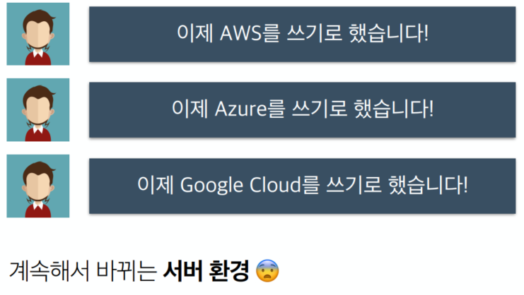
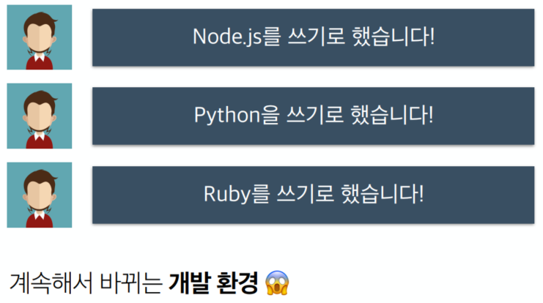
서버를 관리한다는 것은…
“도커란 무엇인가“, https://www.inflearn.com/course/도커-입문/

Slide 26
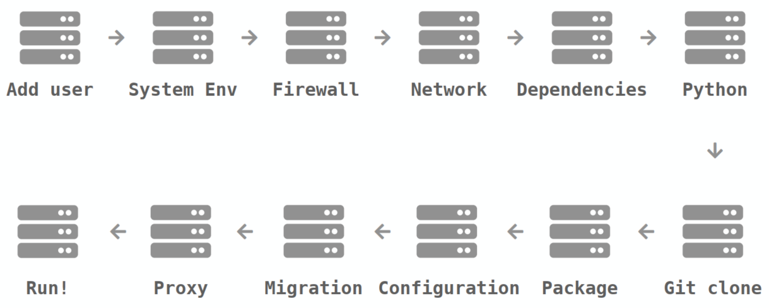
서버를 관리한다는 것은…
“도커란 무엇인가“, https://www.inflearn.com/course/도커-입문/

Slide 27
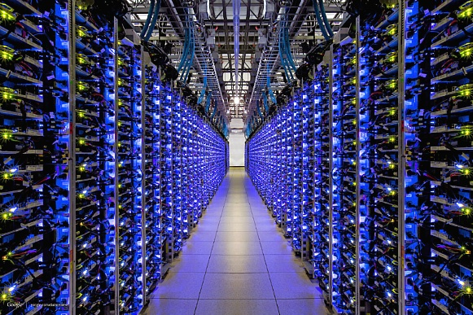
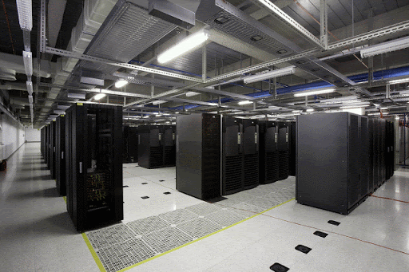
Virtualization

Slide 28
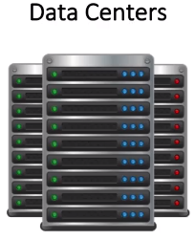
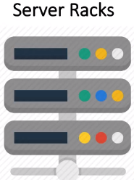
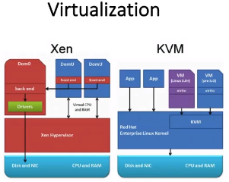
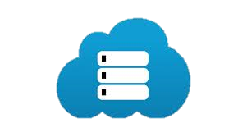
Virtualization

Slide 29
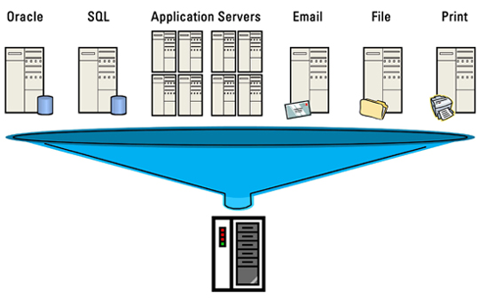
Virtualization
V12n
물리적인 하드웨어 장치를
논리적인 객체로
추상화하는 기술
Is the act of creating a virtual(rather than actual) version of something, including virtual computer hardware platforms, storage devices, and computer network resources.
https://www.energystar.gov/products/low_carbon_it_campaign/12_ways_save_energy_data_center/server_virtualization

Slide 30
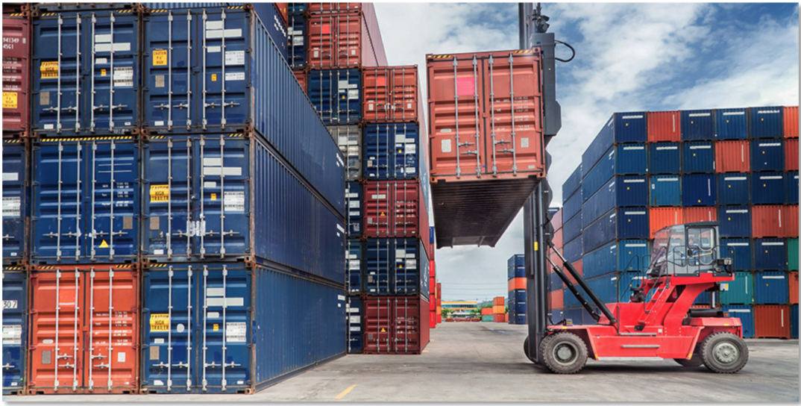
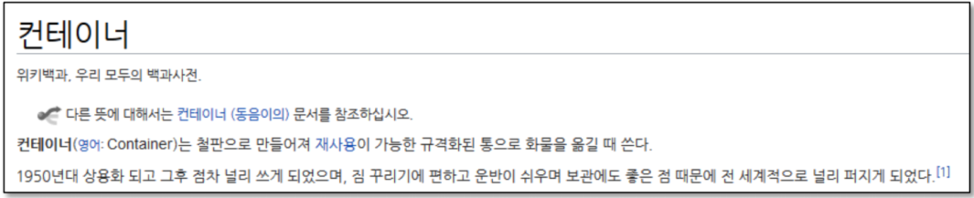
Container

Slide 31
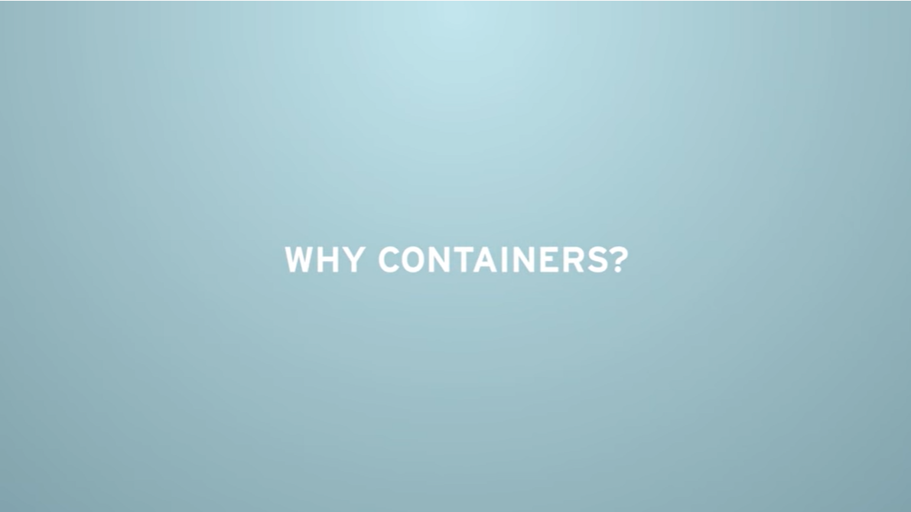
Container
https://www.youtube.com/watch?v=n-JwAM6XF88

Slide 32
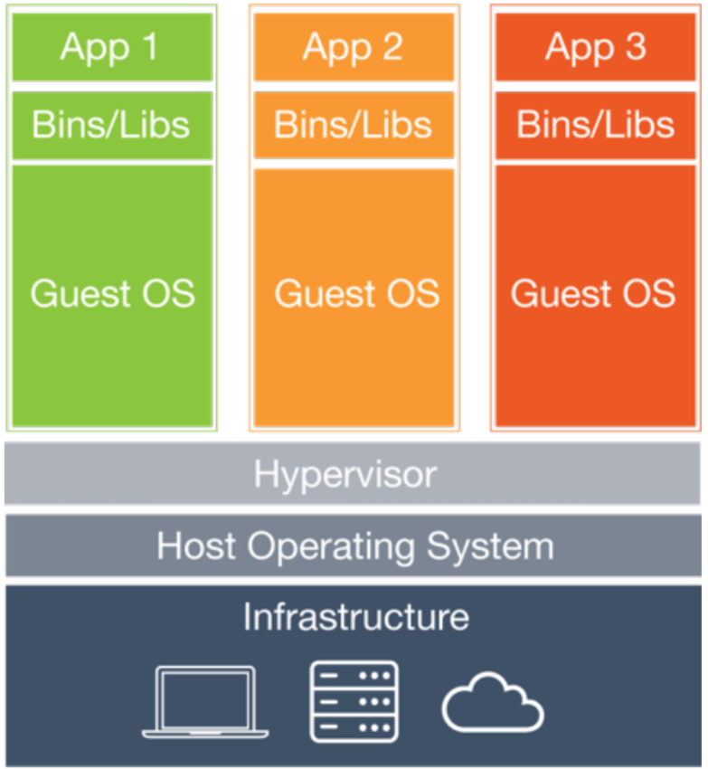
Container (Cont.)
가상머신이 있는데, 왜 컨테이너인가?
➔ 성능차이
CPU, RAM 할당하고, OS 넣고…
성능을 높이는 방법으로…
➔ 가상 머신의 일을 줄이자…
가상 하드웨어를 또 생성?
➔ 하이퍼바이저 빼자…
OS위에 또 OS?
➔ Guest OS 빼자…
자원 할당은 OS Kernel이 하자.
➔ LXC가 하자.

Slide 33

다시 처음으로 돌아가서, 서버를 관리한다는 것은…
1번째 방법은…
문서화를 잘하자.

Slide 34
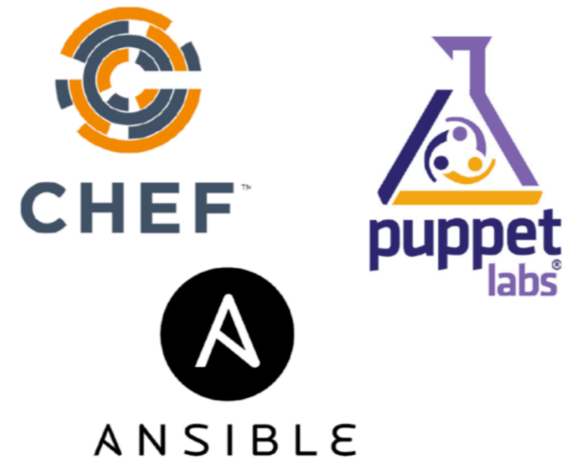
다시 처음으로 돌아가서, 서버를 관리한다는 것은…
2번째 방법은…
툴을 잘 쓰자.

Slide 35

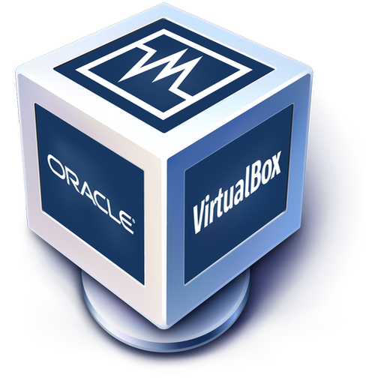
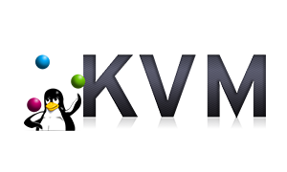

다시 처음으로 돌아가서, 서버를 관리한다는 것은…
3번째 방법은…
가상화

Slide 36
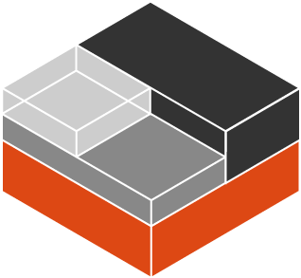
다시 처음으로 돌아가서, 서버를 관리한다는 것은…
4번째 방법은…
리눅스 기능을 이용한 빠르고 효율적인 서버 관리

Slide 37

다시 처음으로 돌아가서, 서버를 관리한다는 것은…
5번째 방법은…
어렵고 복잡한 기능을 사용하기 쉽게!!!

Slide 38
Legacy Enterprise IT Architecture
e-koreatech, “CI/CD를 통한 DevOps 엔지니어링 이해“, 2회차

Slide 39
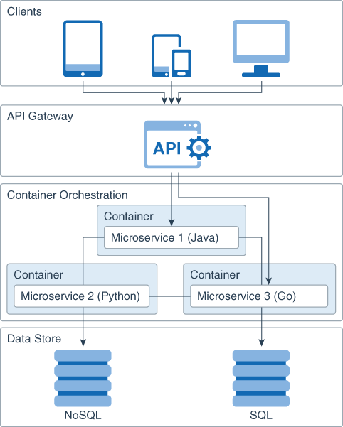
Microservices
Design an application :
Is multilanguage
Easily scalable
Easy to maintain and deploy
Highly available
Minimizes failures
Each microservice owns :
A simple task
Communicates with the clients or with other microservices
Using lightweight communication mechanisms such as REST API requests.
https://docs.oracle.com/en/solutions/learn-architect-microservice/#GUID-1A9ECC2B-F7E6-430F-8EDA-911712467953

Slide 40
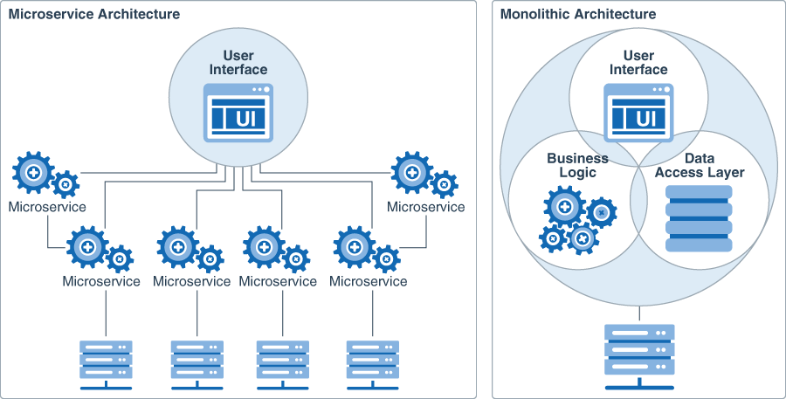
Microservices
https://docs.oracle.com/en/solutions/learn-architect-microservice/#GUID-1A9ECC2B-F7E6-430F-8EDA-911712467953

Slide 41
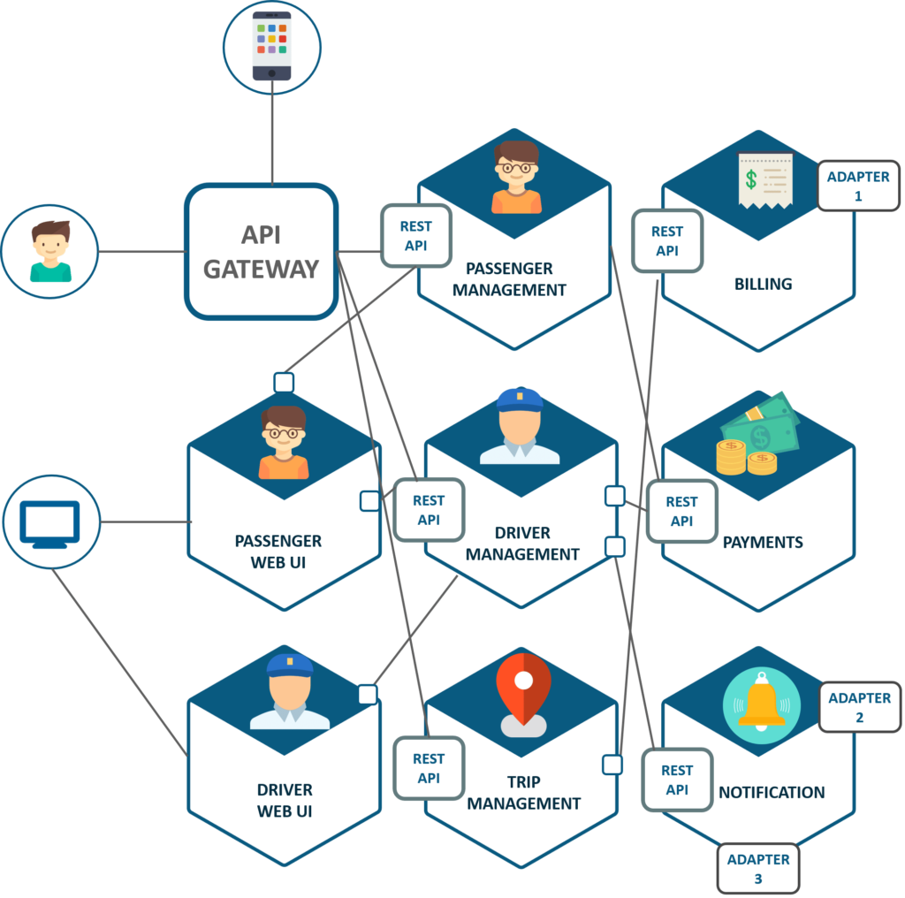
Microservices
https://aionys.com/how-to-benefit-from-microservices-architecture-implementation/

Slide 42
Legacy Enterprise IT Architecture
e-koreatech, “CI/CD를 통한 DevOps 엔지니어링 이해“, 2회차

Slide 43

DevOps
https://devopedia.org/devops

Slide 44
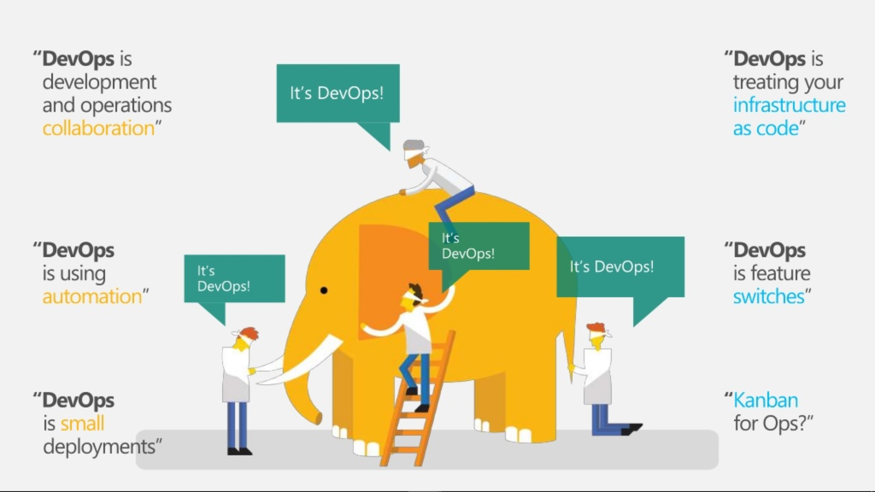
DevOps
https://devopedia.org/devops

Slide 45
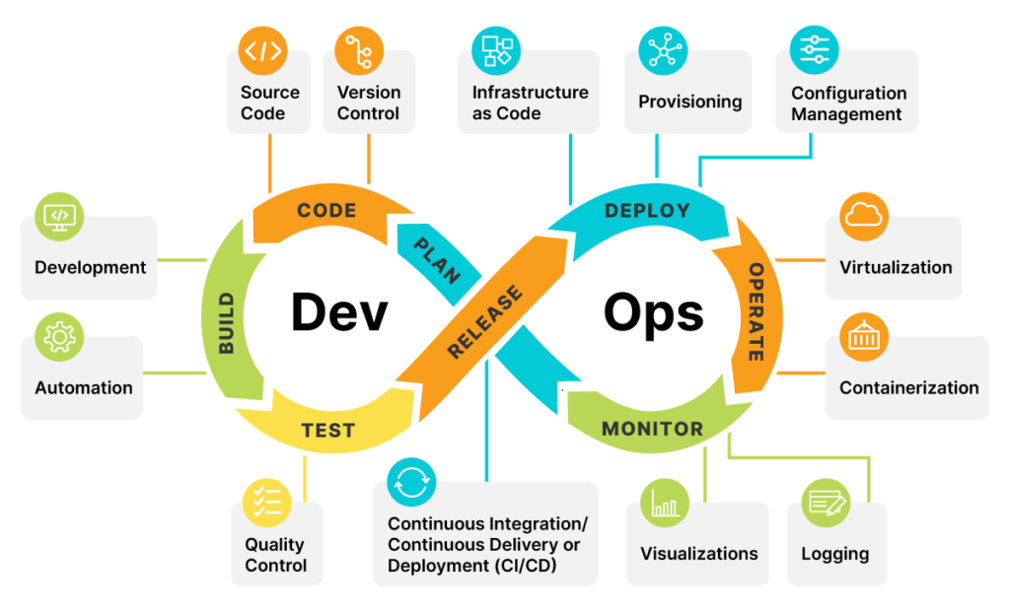
DevOps
https://orangematter.solarwinds.com/2022/03/21/what-is-devops/

Slide 46
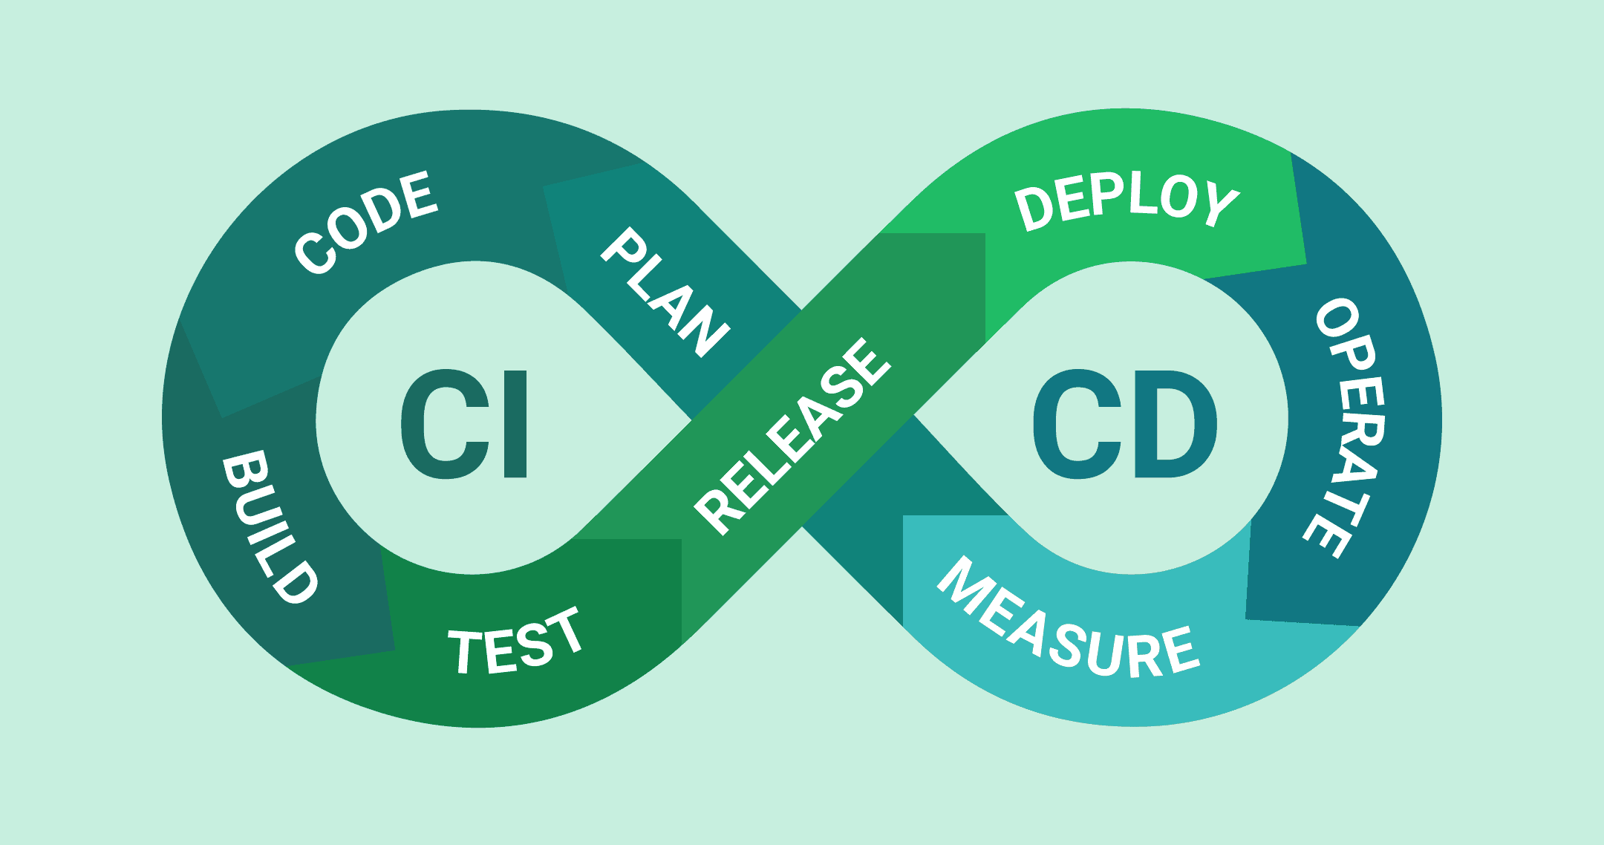
CI/CD
https://velog.io/@cham/CICD-CICD%EB%9E%80

Slide 47
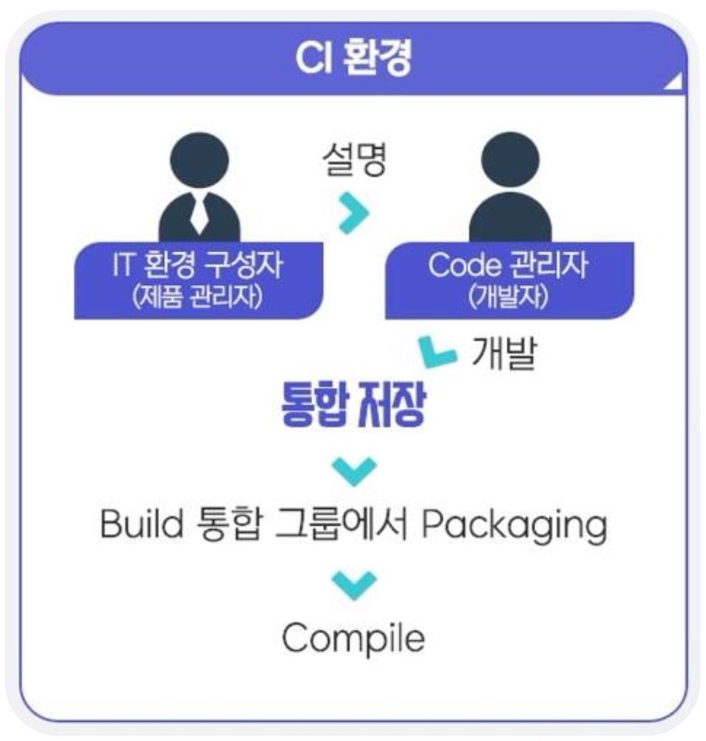
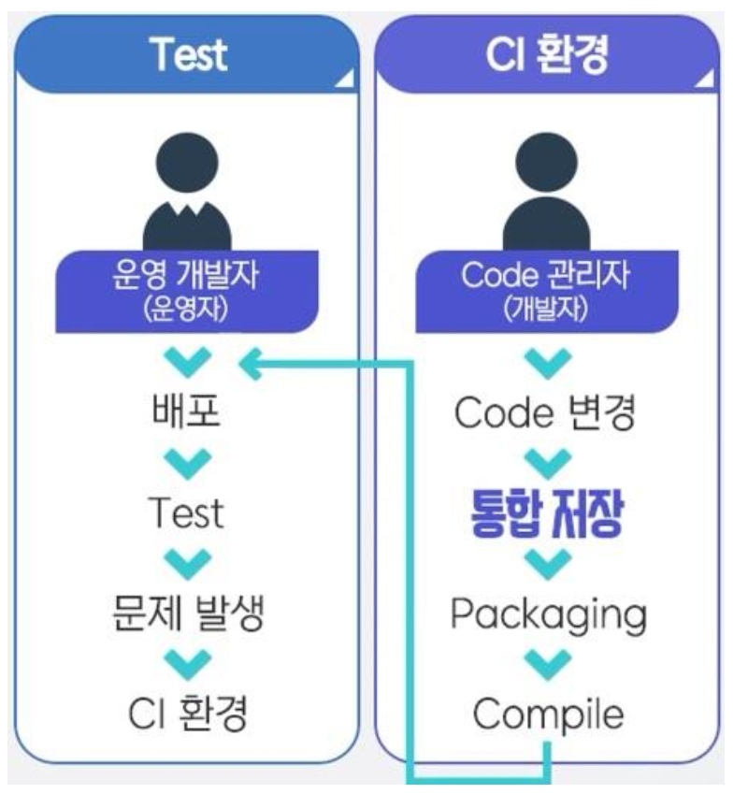
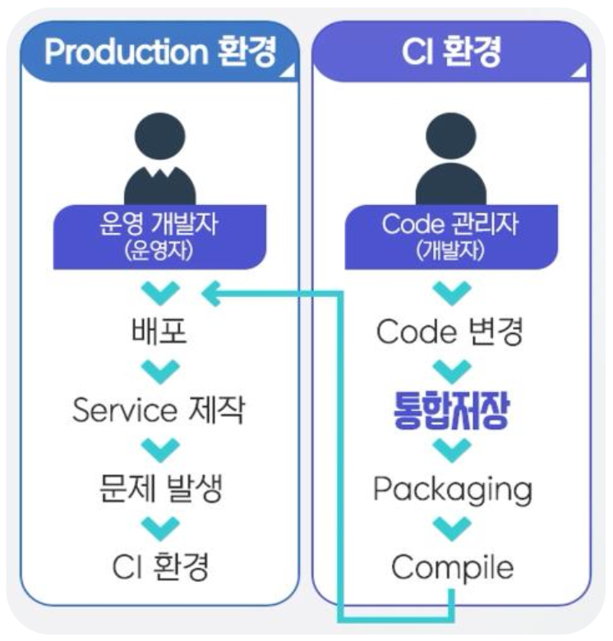
CI/CD
e-koreatech, “CI/CD를 통한 DevOps 엔지니어링 이해“, 1회차

Slide 48
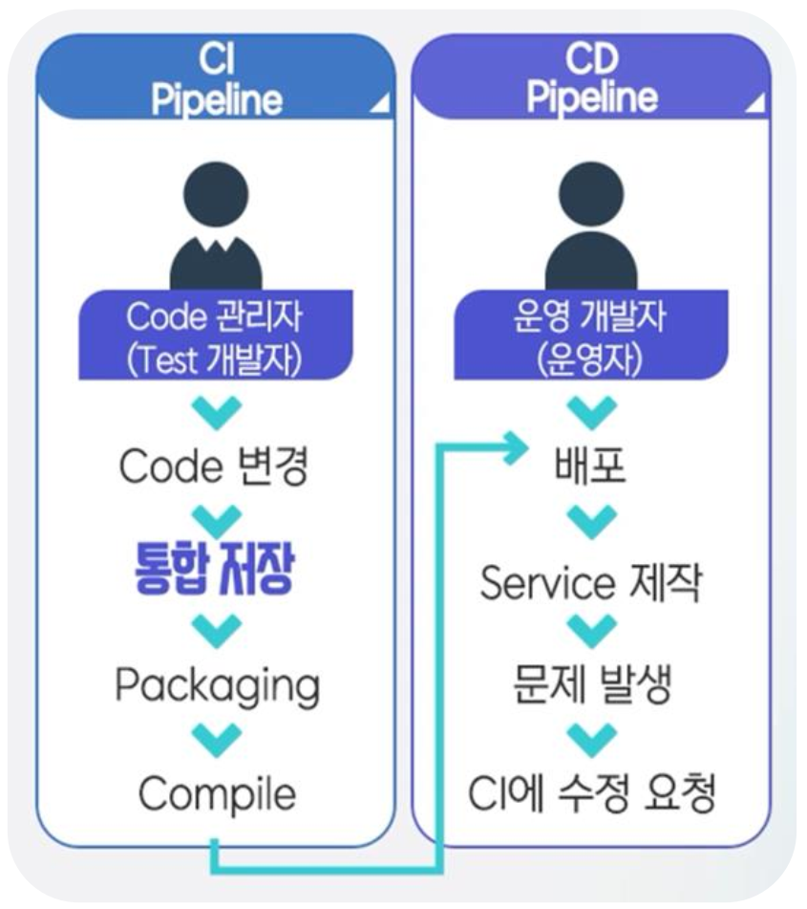

CI/CD
SRE(Site Reliability Engineering) or DevOps Engineer
e-koreatech, “CI/CD를 통한 DevOps 엔지니어링 이해“, 1회차

Slide 49
DevOps

Slide 50
What is Devops?
DevOps is a methodology in the software development and IT industry. Used as a set of practices and tools, DevOps integrates and automates the work of software development (Dev) and IT operations (Ops) as a means for improving and shortening the systems development life cycle.
- https://en.wikipedia.org/wiki/DevOps
데브옵스(DevOps)는 소프트웨어의 개발(Development)과 운영(Operations)의 합성어로서, 소프트웨어 개발자와 정보기술 전문가 간의 소통, 협업 및 통합을 강조하는 개발 환경이나 문화를 말한다. 데브옵스는 소프트웨어 개발조직과 운영조직간의 상호 의존적 대응이며 조직이 소프트웨어 제품과 서비스를 빠른 시간에 개발 및 배포하는 것을 목적으로 한다.
- https://ko.wikipedia.org/wiki/데브옵스

Slide 51
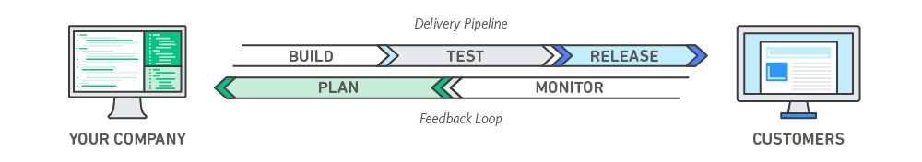
What is Devops?
Dev(개발)과 Ops(운용)이 긴밀히 협조 및 연계하여 비즈니스 측면이 가치를 높이는 근무 방식과 문화를 말한다.
-카와무라 세이고 외 4명 저, 양성건 역, IT 운용체제 변화를 위한 데브옵스, p.10
DevOps는 애플리케이션과 서비스를 빠른 속도로 제공할 수 있도록 조직의 역량을 향상시키는 문화 철학, 방식 및 도구의 조합입니다. 기존의 소프트웨어 개발 및 인프라 관리 프로세스를 사용하는 조직보다 제품을 더 빠르게 혁신하고 개선할 수 있습니다. 이러한 빠른 속도를 통해 조직은 고객을 더 잘 지원하고 시장에서 좀 더 효과적으로 경쟁할 수 있습니다.
- https://aws.amazon.com/ko/devops/what-is-devops/

Slide 52
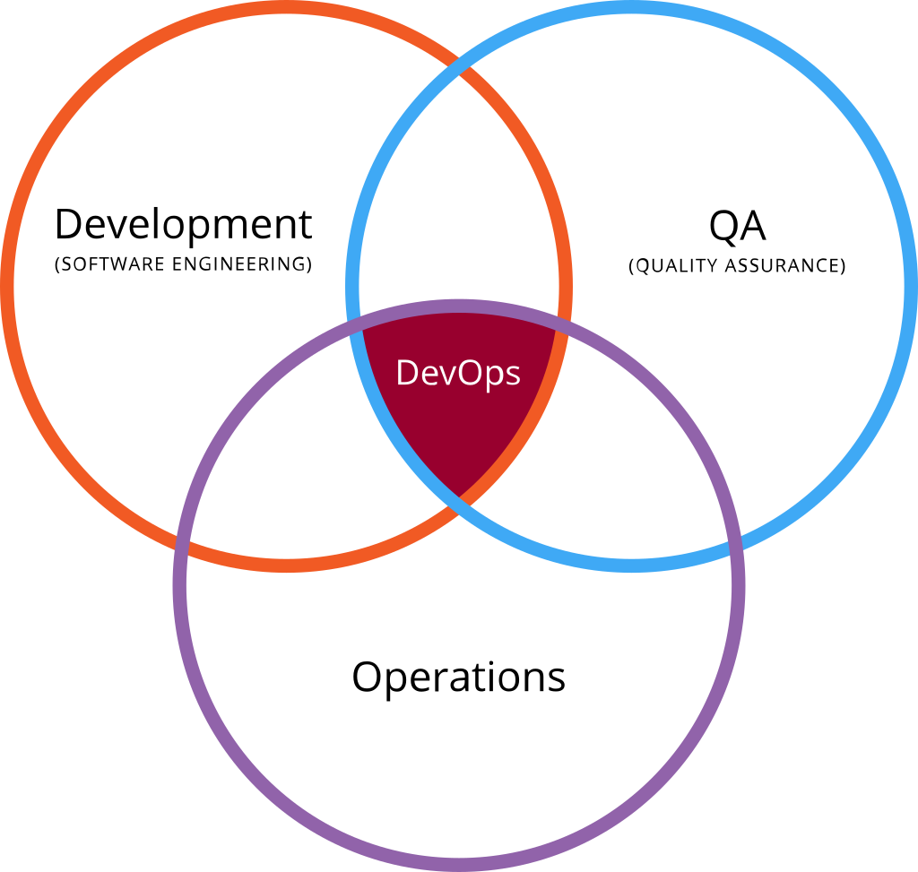
What is Devops?
https://devopedia.org/devops
https://ko.wikipedia.org/wiki/%EB%8D%B0%EB%B8%8C%EC%98%B5%EC%8A%A4

Slide 53
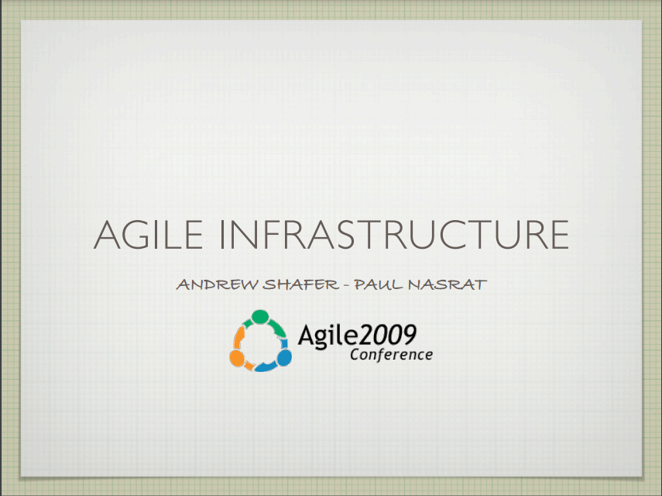
History
In 2008, Agile 2008 Conference
Partick Debois
Agile Infrastructure & Operations
agile-infrastrucre-agile2008.pdf
In 2009, Agile 2009 Conference
Andrew Shafer
Agile Infrastructure
usersandrewdocumentsinfrastructure-agile09-090828232955-phpapp01.pdf
In 2009, Velocity Conference
Flickr Engineer
10+ Deploys per Day : Dev and Ops Cooperation at Flickr
allspawhammondvelocity2009-090623161942-phpapp01.pdf

Slide 54


History
In 2009, The first conference named DevOps Days was held in Ghent, Belgium.
https://www.jedi.be/blog/2009/11/15/devopsdays09-two-weeks-later/
https://legacy.devopsdays.org/events/2009-ghent/

Slide 55
Relationship to other approaches
Agile
Site-reliability Engineering(SRE)
ArchOps
GitOps
CI/CD
Toyota Production System
Microservice

Slide 56

DevOps Toolchain
https://en.wikipedia.org/wiki/DevOps_toolchain

Slide 57
DevOps Toolchain (Cont.)
Plan is composed of two things: define and plan
This activity refers to the business value and application requirements.
Plan activities include:
Production metrics, objects and feedback
Requirements
Business metrics
Update release metrics
Release plan, timing and business case
Security policy and requirement

Slide 58
DevOps Toolchain (Cont.)
Create is composed of he building, coding, and configuring of the software development process.
Create activities include:
Design of the software and configuration
Coding including code quality and performance
Software build and build performance
Release candidate

Slide 59
DevOps Toolchain (Cont.)
Verify directly associated with ensuring the quality of the software release.
Activities designed to ensure code quality is maintained and the highest quality is deployed to production.
Verify activities include:
Acceptance testing
Regression testing
Security and vulnerability analysis
Performance
Configuration testing

Slide 60
DevOps Toolchain (Cont.)
Packaging refers to the activities involved once the release is ready for deployment, often also referred to as staging or Preproduction.
Packaging activities include:
Approval/preapprovals
Package configuration
Triggered releases
Release staging and holding

Slide 61
DevOps Toolchain (Cont.)
Release related activities include schedule, orchestration, provisioning and deploying software into production and targeted environment.
Release activities include:
Release coordination
Deploying and promoting applications
Fallbacks and recovery
Scheduled/timed releases

Slide 62
DevOps Toolchain (Cont.)
Configure activities fall under the operation side of DevOps.
Once software is deployed, there may be additional IT infrastructure provisioning and configuration activities required.
Configure activities include:
Infrastructure storage, database and
network provisioning and configuring.
Application provision and configuration.

Slide 63
DevOps Toolchain (Cont.)
Monitor allows IT organization to identify specific issues of specific releases and to understand the impact on end-users.
Monitor activities include:
Performance of IT infrastructure
End-user response and experience
Production metrics and statistics

Slide 64
DevOps Toolchain (Cont.)
Version Control is the management of changes to documents, computer programs, large web sites, and other collections of information.
Version Control activities include:
Non-linear development
Distributed development
Compatibility with existent systems and
protocols
Toolkit-based design

Slide 65

https://www.hostreview.com/blog/191015-how-to-build-a-cloud-toolchain-in-devops

Slide 66

More DevOps

Slide 67

The SDLC Model
Software development life cycle (SDLC) models show the ways to navigate through the complex and demanding process of software building.
Today, there are more than 50 recognized SDLC models in use.
None of them is perfect, and each brings its favorable aspects and disadvantages for a specific software development project or a team.
https://www.scnsoft.com/blog/software-development-models

Slide 68

The Waterfall Model
Movement is always forward from phase to phase
Management often must sign off on deliverables from each phase
Advantage: accountability
Disadvantage: inflexibility
https://www.cs.odu.edu/~zeil/cs250/latest/Public/waterfall/waterfall__html.html

Slide 69

The Agile Methodology
Is an approach that focused on continual improvement through iterative work, changes and updates.
Cycling through phases of planning, design, development, testing and deployed, it is intended to deliver something of value sooner and iterate upon it over time
https://eoiinconnect.com/what-is-agile-methodology/

Slide 70

Waterfall vs Agile
http://www.differencebetween.net/technology/software-technology/difference-between-agile-and-waterfal/

Slide 71

PDCA Cycle vs. DevOps
Is a project management framework that businesses can use to implement incremental change.
PDCA stands for plan, do, check, and act.
What distinguishes PDCA is that this framework is designed to help teams make small, incremental changes and test each step’s success or failure before moving onto another one.
https://kanbanzone.com/2021/what-is-pdca-cycle/

Slide 72
개발과 운용의 연계를 뒷받침하는 도구를 형성하는 요소
요소명 | 설명
추상화 | 모든 리소스를 추상화하여 어떠한 플랫폼의 차이도 흡수하고, 전문성과 복잡성을 절감하는 것
자동화 | 추상화된 리소스 이용의 자동화를 가능하게 하고, 전문성이나 개발과 운용을 하는 인적 부담을 줄여 주는 것
공통화 | 공통의 비전 관리 시스템, 커뮤니케이션 도구를 이용하여 정보를 가시화하고 개발과 운용의 긴밀한 관계를 구축하는 것
지속적 통합 | 개발과 운용의 개발 및 구축 방법 통일화로 개선 속도를 비약적으로 신장하는 것
모니터링 | 리소스 정보를 일원화하여 가시화하고 개발과 운용이 긴밀하게 협력할 수 있는 관계를 구축하는 것
카와무라 세이고 외 4명 저, 양성건 역, IT 운용체제 변화를 위한 데브옵스, p.24

Slide 73

개발과 운용의 연계를 뒷받침하는 도구를 형성하는 요소 - 추상화
추상화: 모든 리소스가 추상화되지 않는 플랫폼의 차이도 흡수하는 것을 의미
DevOps에서는 추상화에 의한 인프라의 전문성과 복잡성을 배제함으로 개발 부문에서 인프라의 구성이나 설정으로 접근 가능
https://transferhwang.tistory.com/31

Slide 74
개발과 운용의 연계를 뒷받침하는 도구를 형성하는 요소 - 자동화
자동화: 기계적으로 프로그램을 통해 제어하여 사람의 조작을 필요로 하지 않는 작업
REST API를 사용하여 리소스 상태를 변경하는 절차를 프로그램화하여, 기존의 변경 절차서 등을 작성하여 수작업했던 작업을 기계적으로 자동으로 수행가능
자동화는 오픈 소스 형태의 다양한 소프트웨어 조합하는 것으로 가능함.

Slide 75








개발과 운용의 연계를 뒷받침하는 도구를 형성하는 요소 - 공통화
Issue Tracking Systems
JIRA, Redmine, Trac
Communication Tools
Slack, Trello
SCM(Software Configuration Management)
git, GitHub, Subversion

Slide 76



개발과 운용의 연계를 뒷받침하는 도구를 형성하는 요소 - 지속적 통합
Agile 개발에서 지속적 통합은 Build 및 정적 및 동적 테스트를 빈번하게 계속적으로 실시하는 것을 의미
Continuous Integration(CI)
Code로 인해 발생하는 문제를 조기 발견하고, Build, 테스트에 관계된 작업 비용의 낮춤, 테스트 상황의 가시화 등의 장점이 있음.
Jenkins, Travis CI, CircleCI

Slide 77

개발과 운용의 연계를 뒷받침하는 도구를 형성하는 요소 - 모니터링
시스템 상황을 실시간으로 정확히 관측
PDCA Cycle에서 Check(평가)를 하기 위한 기반
Resource 상태를 지속적으로 취득하고 시각화하는 Matrix Monitoring, 서비스 이용자의 Web Page 접속 수 등을 수치화하여 정량적 분석 실시하게 함.
https://www.iworldtoday.com/news/userArticlePhoto.html

Slide 78
DevOps Practices in AWS
Continuous Integration
Continuous Delivery
Microservices
Infrastructure as Code
Monitoring and Logging
Communication and Collaboration
Refer to https://aws.amazon.com/devops/what-is-devops/?nc1=h_ls

Slide 79
Monolithic vs MSA

Slide 80

Monolithic Architecture
Is a traditional model of a software program.
Is built as a unified unit that is self-contained and independent from other applications.
Is a singular, large computing network with one code base that couples all of the business concerns together.
https://www.atlassian.com/microservices/microservices-architecture/microservices-vs-monolith

Slide 81
Monolithic Architecture (Cont.)
The advantages of a monolithic architecture include:
Easy deployment – One executable file or directory makes deployment easier.
Development – When an application is built with one code base, it is easier to develop.
Performance – In a centralized code base and repository, one API can often perform the same function that numerous APIs perform with microservices.
Simplified testing – Since a monolithic application is a single, centralized unit, end-to-end testing can be performed faster than with a distributed application.
Easy debugging – With all code located in one place, it’s easier to follow a request and find an issue.

Slide 82
Monolithic Architecture (Cont.)
The disadvantages of a monolithic architecture include:
Slower development speed – A large, monolithic application makes development more complex and slower.
Scalability – You can’t scale individual components.
Reliability – If there’s an error in any module, it could affect the entire application’s availability.
Barrier to technology adoption – Any changes in the framework or language affects the entire application, making changes often expensive and time-consuming.
Lack of flexibility – A monolith is constrained by the technologies already used in the monolith.
Deployment – A small change to a monolithic application requires the redeployment of the entire monolith.

Slide 83

Microservice Architecture
Relies on a series of independently deployable services.
These services have their own business logic and database with a specific goal.
Updating, testing, deployment, and scaling occur within each service.
https://www.atlassian.com/microservices/microservices-architecture/microservices-vs-monolith

Slide 84
Microservice Architecture (Cont.)
Decouple major business, domain-specific concerns into separate, independent code bases.
Don’t reduce complexity, but they make any complexity visible and more manageable by separating tasks into smaller processes that function independently of each other and contribute to the overall whole.
Adopting microservices often goes hand in hand with DevOps, since they are the basis for continuous delivery practices that allow teams to adapt quickly to user requirements.

Slide 85

Microservice Architecture (Cont.)
The advantages of microservices are:
Agility
Flexible scaling
Continuous deployment
Highly maintainable and testable
Independently deployable
Technology flexibility
High reliability
Happier teams
https://aws.amazon.com/microservices/

Slide 86
Microservice Architecture (Cont.)
The disadvantages of microservices are:
Development sprawl
Exponential infrastructure costs
Added organizational overhead
Debugging challenges
Lack of standardization
Lack of clear ownership

